Slide 1
Hospital Management System Presentation

Slide 2
Project Members
Shayan Ali
Ameer Hamza
39293
36191

Slide 3
Data structures used in this project
Linked List
Reason/Advantages for Choosing the data structure
Linked list is a Dynamic data structure
Insertion and deletion operation are easier
Efficient memory utilization For Example no need to pre allocate memory

Slide 4
Libraries used in this project
#include<iostream> iostream is a header file that contains functions for input/output operations ( cin and cout ).
#include<string.h> String handling

Slide 5
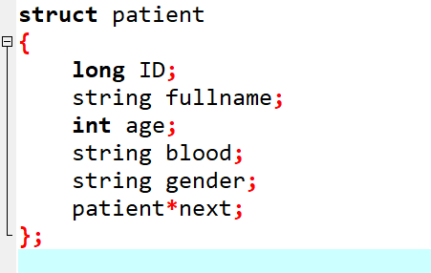
define its data types
Create structure variables
Structure variables or fields
ID
Full Name
Age
Blood
Gender
Patient *next; is pointer which store the address of next node

Slide 6
Function used in this project
/// function declaration
patient input();
void insrtEnd();
void insertStart();
void patientsout();
void patientslist();

Slide 7
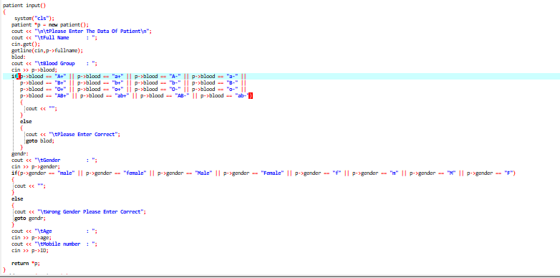
patient input(); take inpute from user

Slide 8
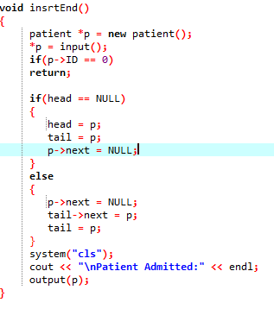
void insrtEnd();

Slide 9
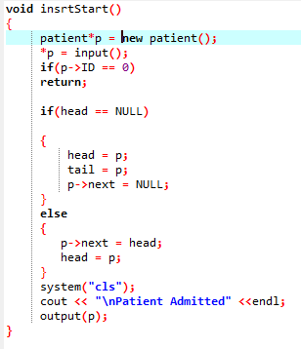
void insrtStart();

Slide 10
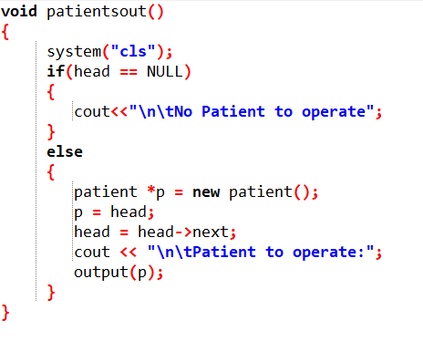
void patientsout();

Slide 11
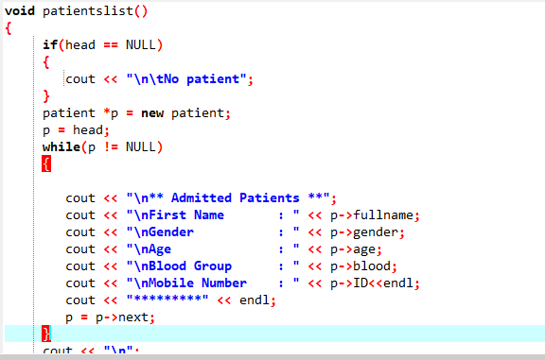
void patientslist();

Slide 12
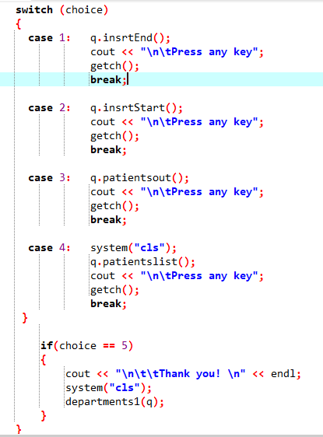
Switch case if we press 1 then insertatend function will execute.Similarly other will also exute on pressing

Slide 13
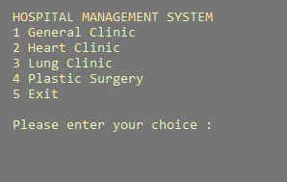
Home Page of Project
It contains several button like
General Clinic
Heart Clinic
Lung Clinic
Plastic Surgery
Exit

Slide 14
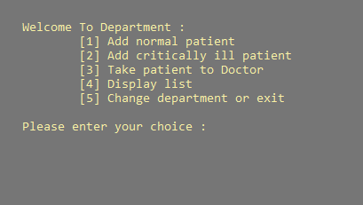
Press General clinic

Slide 15
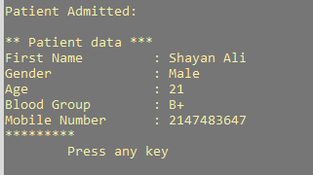
Add Normal Patient

Slide 16
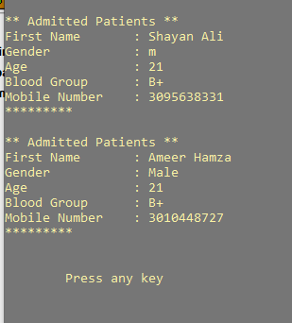
Display List of Patient

Slide 17
Thankyou

